Slide 1
Optimizing Real-Time ML Inference with NVIDIA Triton Inference Server
- Sharmili Srinivasan (ML Engineer at PayPal)

Slide 2
Table of Contents
Target Audience and What to expect?
Target Audience
Students, Freshers, Beginners
Prerequisites
Docker Fundamentals, Python Basics, ML Basics
What to expect?
Introductions to Real Time Inferencing and Triton
Highlights on Triton’s distinguishing features
Hands-on basic setup
Demo on quick-win optimizations
Glimpse of advance optimization features

Slide 3
Table of Contents
Table of contents
Real Time Inferencing
Introduction
Expectations
Why Triton Inference Server?
Triton’s Features - Highlights
Hands-on Time
Q & A

Slide 4




Brief about me..
Sharmili Srinivasan
ML Engineer @ PayPal
9+ years of industry experience
Programmer by passion and profession
Areas of interest and experience:
ML Engineering
MLOps (E2E scaled ML model deployments)
Big Data Engineering
Reach me
https://www.linkedin.com/in/sharmili-srinivasan-40925a41/
sharmilisrinivasan@gmail.com
https://github.com/sharmilisrinivasan

Slide 5
Real Time Inferencing

Slide 6
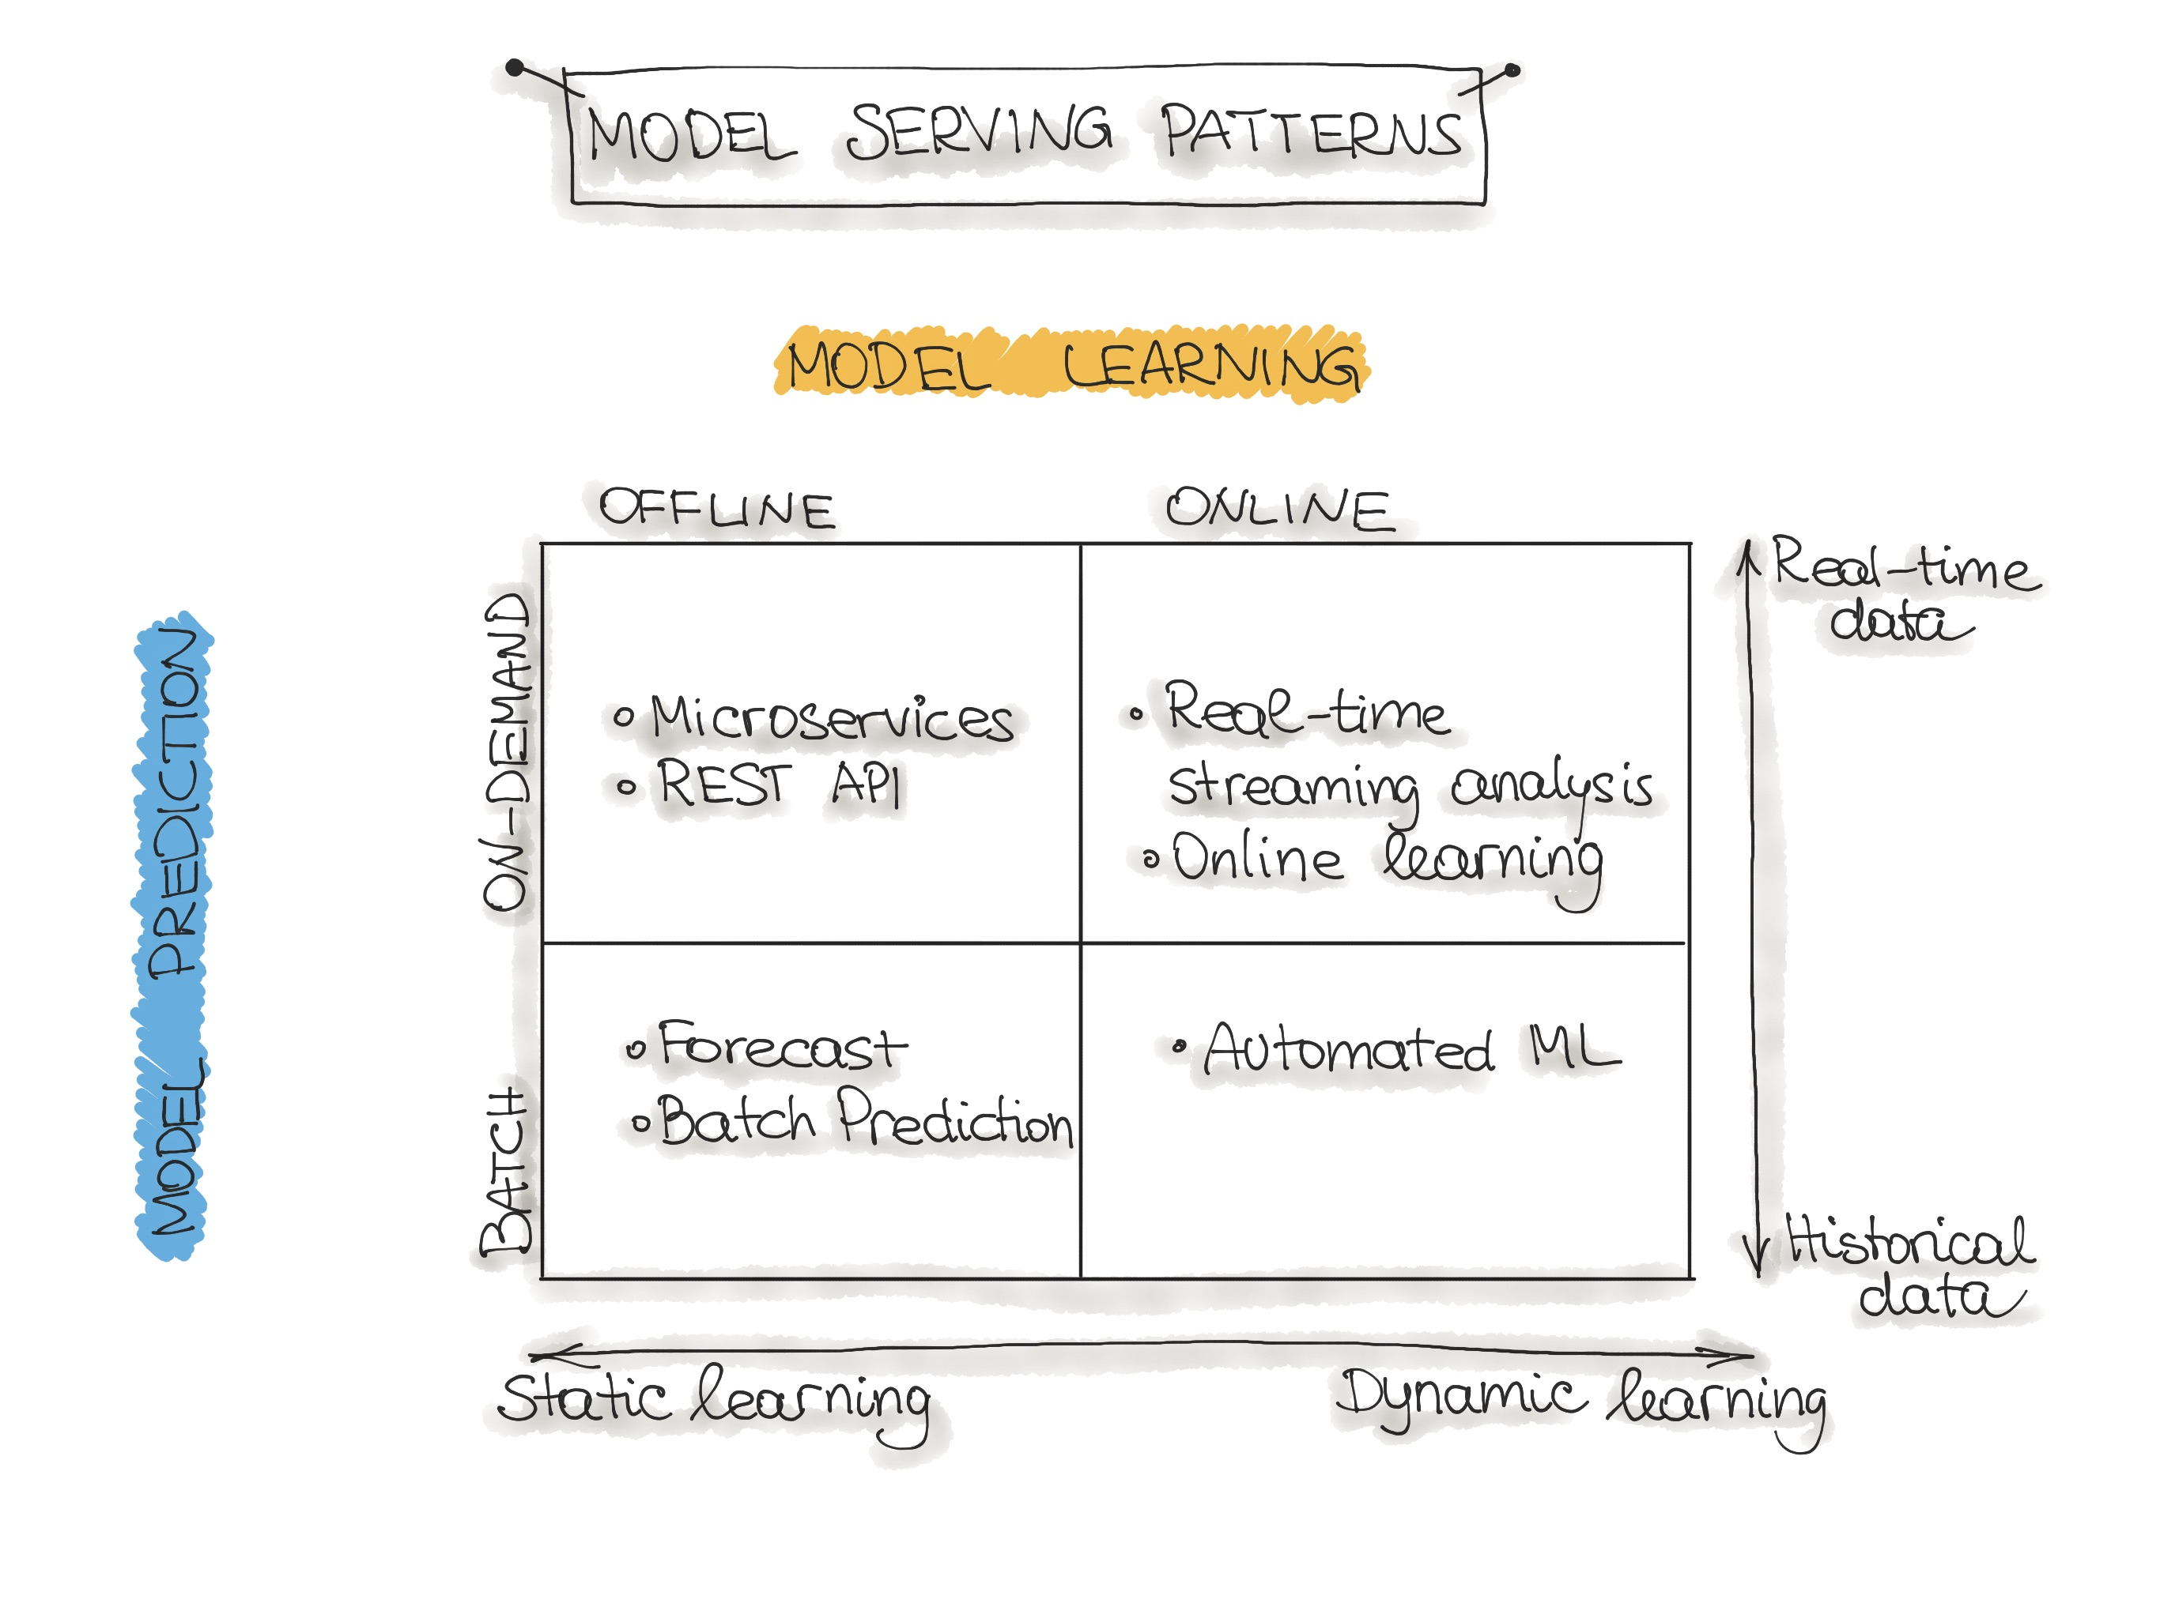
(Near) Real Time Inferencing –Introduction
Brief about me..
Source: https://ml-ops.org/content/three-levels-of-ml-software#code-deployment-pipelines

Slide 7
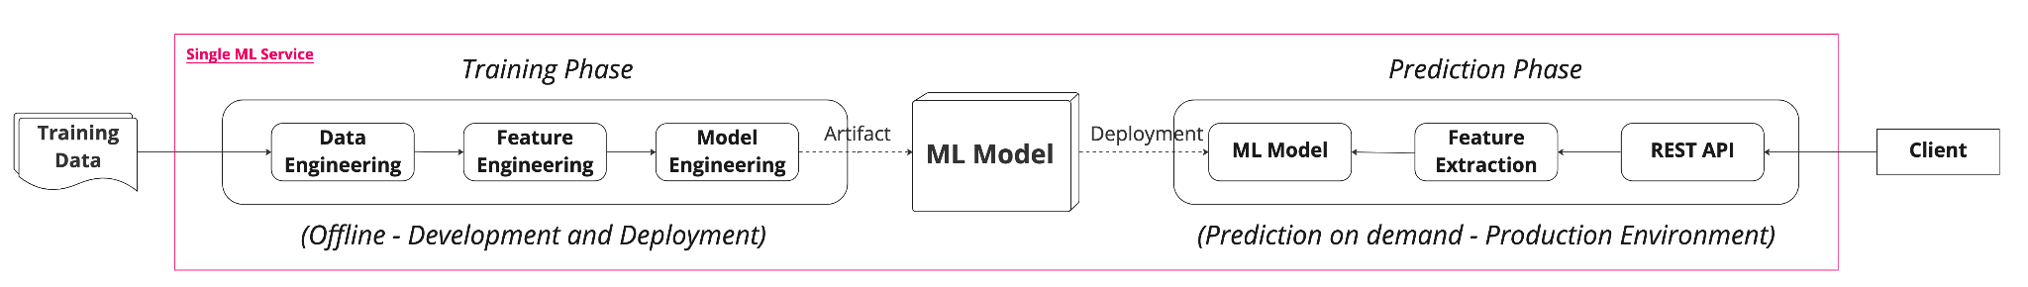
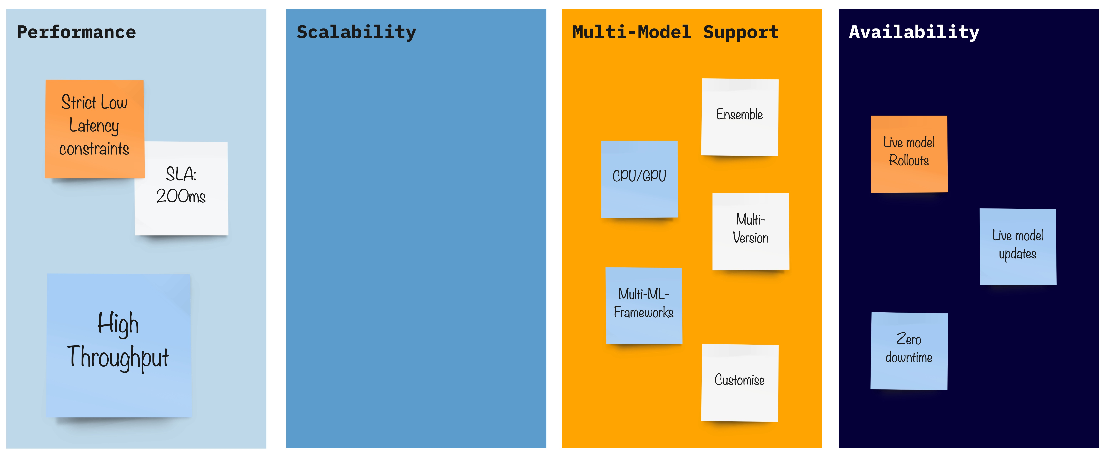
(Near) Real Time Inferencing – Expectations
Brief about me..

Slide 8
Why Triton Inference Server?

Slide 9
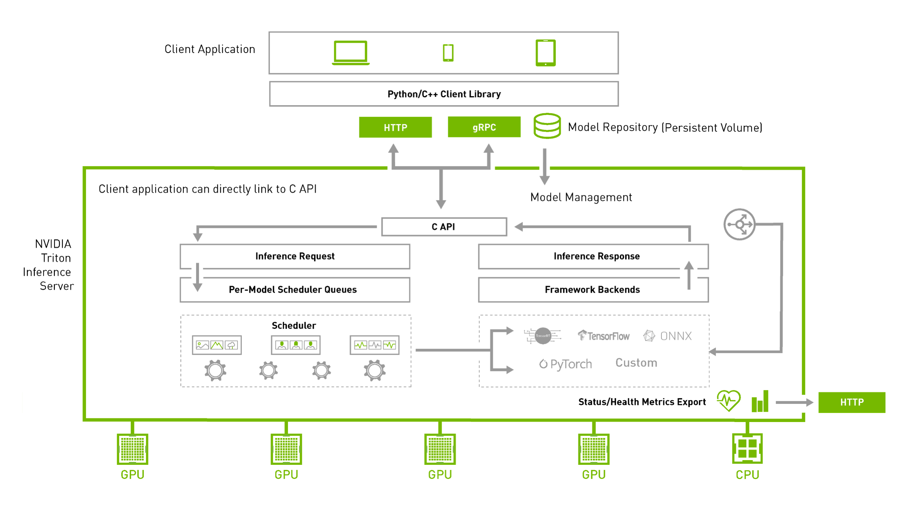
Why Triton Inference Server?
Brief about me..
Source: https://developer.nvidia.com/nvidia-triton-inference-server

Slide 10
Why Triton Inference Server?
Brief about me..
Source: https://developer.nvidia.com/nvidia-triton-inference-server

Slide 11
Why Triton Inference Server?
Brief about me..
Source: https://developer.nvidia.com/nvidia-triton-inference-server

Slide 12
Why Triton Inference Server?
Brief about me..
Source: https://developer.nvidia.com/nvidia-triton-inference-server

Slide 13
Why Triton Inference Server?
Brief about me..
Source: https://developer.nvidia.com/nvidia-triton-inference-server

Slide 14
Why Triton Inference Server?
Brief about me..
Source: https://developer.nvidia.com/nvidia-triton-inference-server

Slide 15
Why Triton Inference Server?
Brief about me..
← Model Analyzer
Source: https://developer.nvidia.com/nvidia-triton-inference-server

Slide 16
Triton’s Features - Highlights

Slide 17
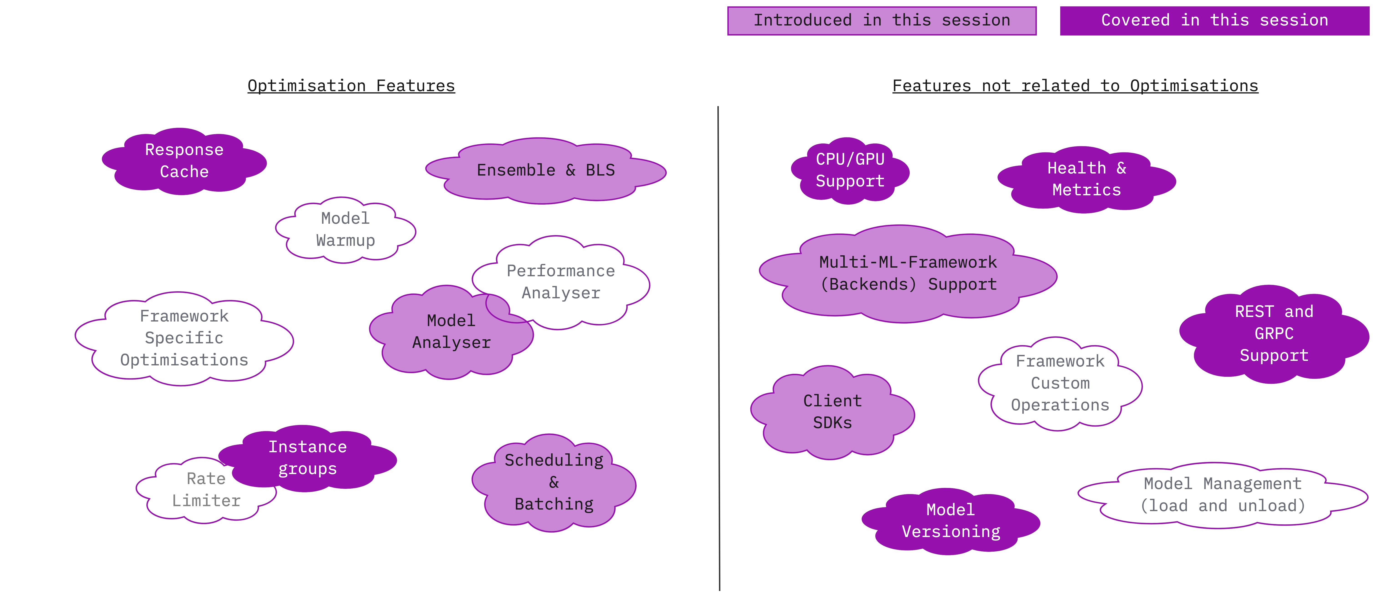
Triton’s Features - Highlights
Brief about me..
Source: https://github.com/triton-inference-server/server/blob/main/docs/README.md

Slide 18
Hands-on Time

Slide 19
DataHour : Q&A

Slide 20
Thank you!

